Slide 1
ANISHINAABE NATION MINNESOTA
Potential Government Structures

Slide 2
Our ancestral lands have been diminished but we are still here.
Map of Ojibwe Reservations and Reserves
Our traditional lands on Turtle Island BC

Slide 3
Traditionally Anishinaabe society was governed by the “doodem” (clan) Structure
There are many forms of the Doodem structure that differ from community to community. One thing they have in common however is there are 7 principle clans, sometimes 6.

Slide 4
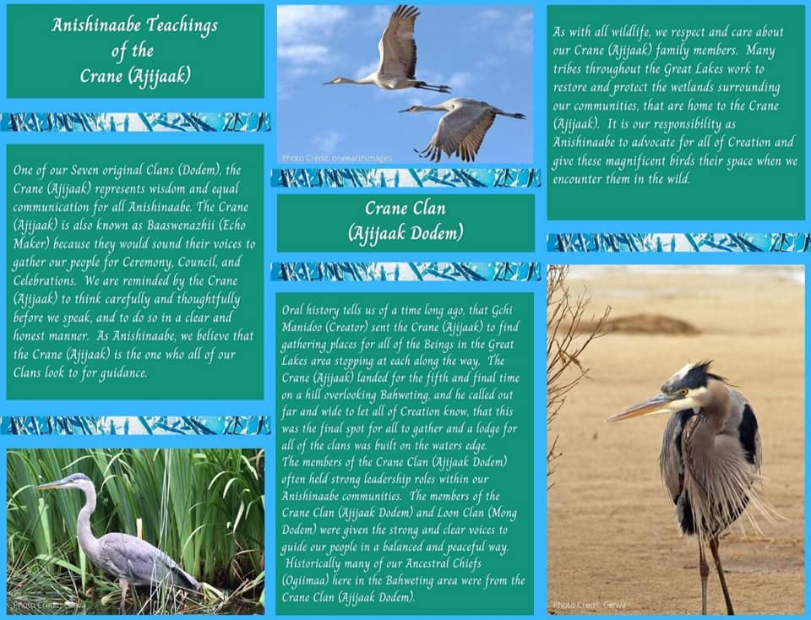

Slide 8
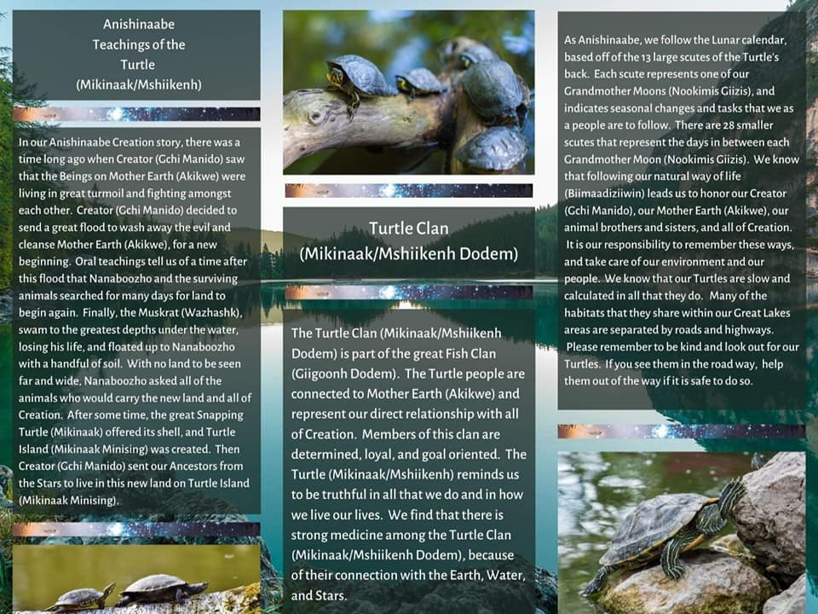

Slide 12
Our Clans are powerful on their own but together we are unconquerable
We are each a plate upon the back of the Mikinaak (turtle) and it is our duty to unite and be strong and connected. Only together could we hope to build a strong shell to protect our future through the storm. We owe it to our ancestors for their sacrifices to move ahead as one with clear minds and pure hearts not only to honor them but to make a better path for the next 7 generations. Giichi-manido gifted us this clan structure as our original form of government to neglect this is to turn our backs on the one whom we owe our very lives to.

Slide 13
Citizen Potawatomi nation legislative districts
Similar to the structure of our Citizen Potawatomi family have done, We can create districts on OUR nations historical territory. Those Ojibwe out side the Territory could be represented in one but equal district.

Slide 14
A more traditional model incorporating six councils
We could implement oversight of the TEC with councils of Elders, Youth, Men and Women all under the community citizen council and the off nation council to insure equal, fair and complete representation

Slide 15
Grand Council made of 2-7 delegates from each Reservation to replace the Secretary of the Interior’s oversite responsibility of our TEC.
We can utilize our clan system or separate Spiritual, Elder, Men, Women, Youth, or other representative body to fill these positions.

Slide 17
Ojibwe Government Structure Elements
Here are some basic elements of an Ojibwe community. Add more and create your own perfect government flow chart.

Slide 18
In his History of the Ojibwe People (1855), William W. Warren recorded 10 major divisions of the Ojibwe in the United States. He mistakenly omitted the Ojibwe located in Michigan, Western Minnesota and Westward, and all of Canada. When identified major historical bands located in Michigan and Ontario are added, the count becomes 15.

Slide 19
Miigwech Bizindawiyeg
Gi-Gagwejiim-ina

